Slide 1


SOFTWARE ENGINEERING (Week-2)
Usama Musharaf
MS-CS (Software Engineering)
Lecturer (Department of Computer Science)
FAST-NUCES Peshawar

Slide 2
Agenda of week # 2
Software Development Process Models
Agile Development

Slide 3
What is a software process?
SP is a set of activities whose goal is the development or evolution of software.
Fundamental activities in all software processes are:
Specification - what the system should do and its development constraints.
Development - production of the software system (design and implementation)
Validation - checking that the software is what the customer wants
Evolution - changing the software in response to changing demands

Slide 4
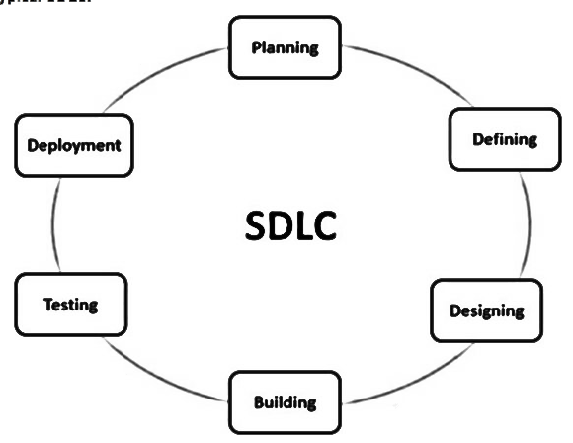
Software Development Life Cycle

Slide 5
Software process models
Waterfall model
V Model
Rapid prototyping model
Evolutionary s/w process Model
Incremental model
Spiral Model
Agile Development
Extreme Programming
Scrum

Slide 6
Waterfall Process Model AKA Linear sequential model
Requirements
Design
Coding
Testing
Maintenance

Slide 7
Waterfall model Advantages
Simple and easy to understand and use
Works well for smaller projects where requirements are very well understood.
Clearly defined stages.
Well understood milestones.
Easy to arrange tasks.
Process and results are well documented.

Slide 8
Waterfall model problems
The drawback of the waterfall model is the difficulty of accommodating change after
the process is underway.
This makes it difficult to respond to changing customer requirements
Therefore, this model is only appropriate when the requirements are well-understood.
Waterfall model describes a process of stepwise refinement

Slide 9
Waterfall Model (Problems)
Doesn't support iteration, so changes can cause confusion
Difficult for customers to state all requirements explicitly and up front
Requires customer patience because a working version of the program doesn't occur until the final phase

Slide 10
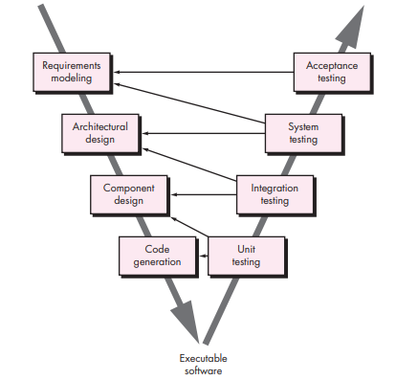
V Model

Slide 11
Rapid Prototyping Process Model
Requirements
Quick Design
Prototype
Evaluate
Design

Slide 12
Rapid Prototyping Model
The Rapid Prototyping Model is used to overcome issues related to understanding and capturing of user requirements.

Slide 13
Evolutionary s/w process Model
Incremental model
Spiral Model

Slide 14
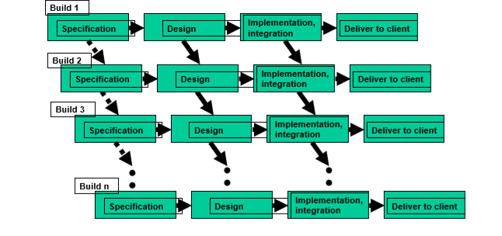
Incremental or Iterative Process Model

Slide 15
Incremental or Iterative Process Model
Rather than deliver the system as a single delivery, the development and delivery is broken down into increments with each increment delivering part of the required functionality.
Once the development of an increment is started, the requirements are frozen though requirements for later increments can continue to evolve.

Slide 16
Incremental or Iterative development advantages
Customer value can be delivered with each increment so system functionality is available earlier.
Early increments act as a prototype to help elicit requirements for later increments.
Lower risk of overall project failure.

Slide 17
Spiral Process Model
The spiral model, originally proposed by Boehm is an evolutionary software process model that couples the iterative nature of prototyping with the controlled and systematic aspects of the linear sequential model.
Using the spiral model, software is developed in a series of incremental releases.

Slide 18
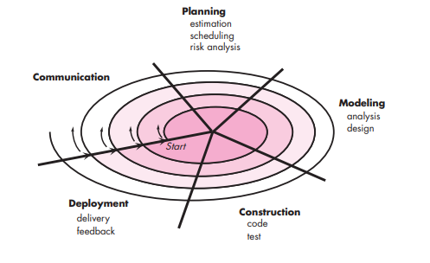
Spiral Process Model

Slide 19
Spiral Model(Description)
Follows an evolutionary approach
Used when requirements are not well understood and risks are high
Operates as a risk-driven model…a go/no-go decision occurs after each complete spiral in order to react to risk determinations
Requires considerable expertise in risk assessment
Serves as a realistic model for large-scale software development
19

Slide 20
General Weaknesses of Evolutionary Process Models
Prototyping poses a problem to project planning because of the uncertain number of iterations required to construct the product
Evolutionary software processes do not establish the maximum speed of the evolution
If too fast, the process will fall into chaos
If too slow, productivity could be affected
20

Slide 21
Agile Development

Slide 22
Common Fears for Developers
The project will produce the wrong product.
The project will produce a product of inferior quality.
The project will be late.
We’ll have to work 80 hour weeks.

Slide 23
What is “Agility”?
Effective (rapid and adaptive) response to change
Effective communication among all stakeholders
Yielding …
Rapid, incremental delivery of software

Slide 24
An Agile Process
Is driven by customer descriptions of what is required (scenarios)
Develops software iteratively with a heavy emphasis on construction activities
Delivers multiple ‘software increments’
Adapts as changes occur

Slide 25
Principles of agile methods

Slide 26
Agile process models
Extreme Programming (XP)
Scrum
Adaptive Software Development
Dynamic System Development Method (DSDM)
Crystal
Feature Driven Development
Agile Modeling (AM)

Slide 27
Extreme Programming (XP)
Perhaps the best-known and most widely used agile method.
Extreme Programming (XP) takes an ‘extreme’ approach to iterative development.
New versions may be built several times per day;
Increments are delivered to customers every 2 weeks;
All tests must be run for every build and the build is only accepted if tests run successfully.

Slide 28
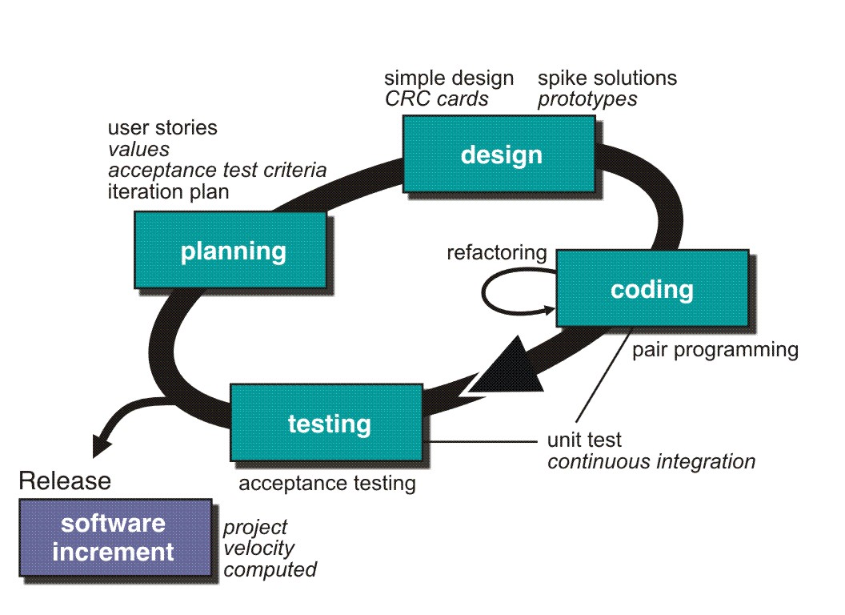
Extreme Programming (XP)

Slide 29
Extreme Programming (XP)
XP Planning
Begins with the creation of user stories
Agile team assesses each story and assigns a cost
Stories are grouped to for a deliverable increment
A commitment is made on delivery date

Slide 30
Requirements scenarios
In XP, user requirements are expressed as scenarios or user stories.
These are written on cards and the development team break them down into implementation tasks. These tasks are the basis of schedule and cost estimates.
The customer chooses the stories for inclusion in the next release based on their priorities and the schedule estimates.

Slide 31
Story card for document downloading

Slide 32
Extreme Programming (XP)
XP Design
Follows the KIS (keep it simple) principle
Encourage the use of CRC (class-responsibility-cards) cards
For difficult design problems, suggests the creation of spike solutions — a design prototype
Encourages refactoring — an iterative refinement of the internal program design

Slide 33
Extreme Programming (XP)
CRC Cards:
Class-responsibility-collaboration (CRC) cards are a tool used in the design of object-oriented software.

Slide 34
Extreme Programming (XP)
CRC Cards:
The card is partitioned into three areas:
On top of the card, the class name
On the left, the responsibilities of the class
On the right, collaborators (other classes) with which this class interacts to fulfill its responsibilities.

Slide 35
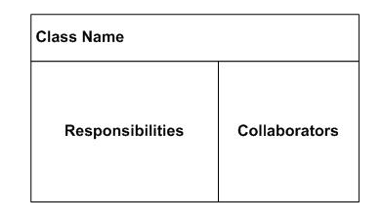
Extreme Programming (XP)
CRC Cards:

Slide 36
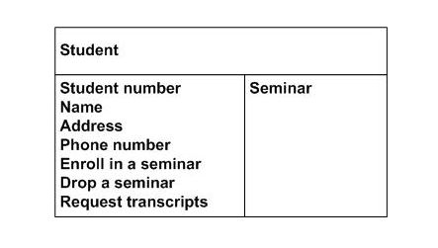
Extreme Programming (XP)
CRC Cards:

Slide 37
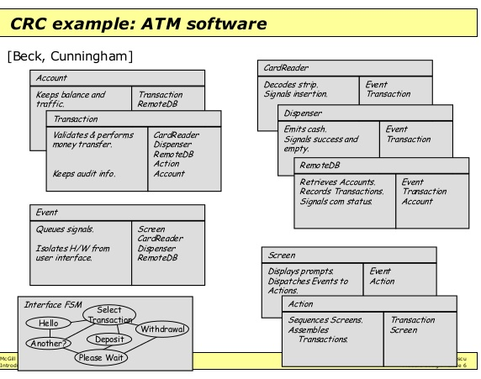

Slide 38
Extreme Programming (XP)
XP Coding
Recommends the construction of a unit test for a store before coding commences
Encourages pair programming
XP Testing
All unit tests are executed daily
Acceptance tests are defined by the customer and executed to assess customer visible functionality

Slide 39
Testing in XP
Test-first development.
Incremental test development from scenarios.
User involvement in test development and validation.

Slide 40
Task cards for document downloading

Slide 41
Test case description

Slide 42
Significance of Test-first development
Writing tests before code clarifies the requirements to be implemented.
Tests are written as programs rather than data so that they can be executed automatically. The test includes a check that it has executed correctly.
All previous and new tests are automatically run when new functionality is added. Thus checking that the new functionality has not introduced errors.

Slide 43
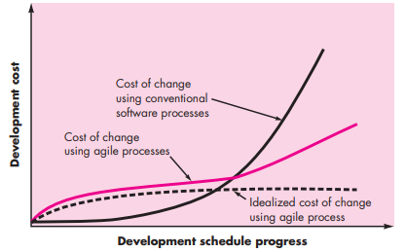
Cost of Change in Agile

Slide 44
SCRUM
Scrum is an Agile framework for completing complex projects.
Scrum originally was formalized for software development projects, but it works well for any complex, innovative scope of work.
Scrum is a team-based approach, to iteratively, incrementally develop systems and products.
when requirements are rapidly changing .

Slide 45
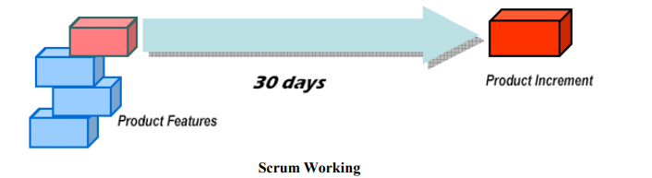
How does SCRUM work?
Small teams (< 10 people)
A series of Sprints (1-4 weeks)

Slide 46
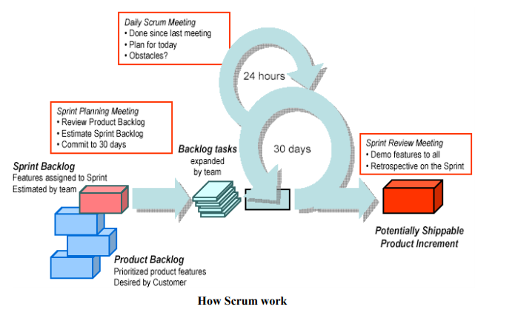
How does SCRUM work?

Slide 47
HAVE A GOO DAY!

